Slide 1
How to Develop a Pix2Pix GAN for Image-to-Image Translation
Date : 2022-01-19

Slide 2
Overview
What is Pix2Pix?
Prerequisites
GAN, Conditional GAN
Pix2Pix
Objection Function
Network Architecture
Generator with skip connection
Discriminator with PatchGAN
Optimization and inference
Experiments with source code
Conclusion

Slide 3
Official Reference
You can check the detailed contents about pix2pix GAN model in the link below
GitHub
https://github.com/phillipi/pix2pix
Paper : Image-to-Image Translation with Conditional Adversarial Networks
https://arxiv.org/abs/1611.07004
Projects
https://phillipi.github.io/pix2pix/

Slide 4
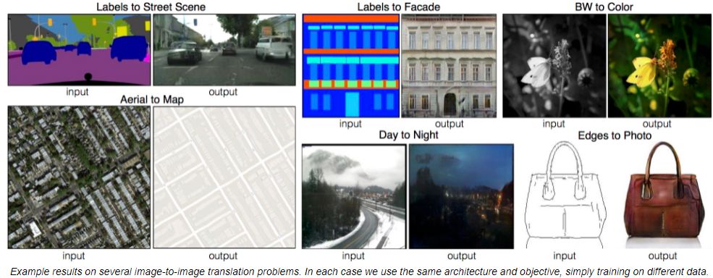
What is Pix2Pix?
Image-to-Image translation is the task that translates images from one domain to another by learning a mapping between the input and output images.
And the models representing these fields(image-to-image translation) are pix2pix and CycleGAN.
Pix2Pix GAN further extends the idea of CGAN, where the images are translated from input to an output image, conditioned on the input image.
https://ysbsb.github.io/gan/2020/06/17/GAN-newbie-guide.html

Slide 5
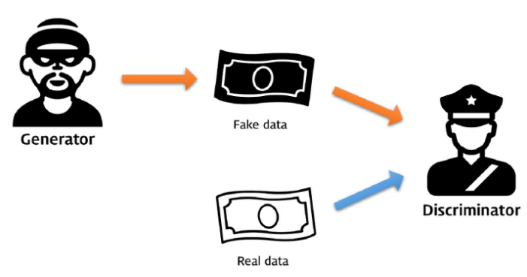
Prerequisites : GAN
Prior to learning up pix2pix modeling, it is easier to understand with basic knowledge of GAN and CGAN. Especially, authors of the paper emphasizes Conditional Adversarial Networks, CGAN.
Generative adversarial network, or GAN for short, are an approach to generative modeling using deep learning methods, such as convolutional neural networks(CNN).
The generator model that we train to generate new examples, and the discriminator model that tries to classify examples as either real(from the domain) or fake(generated).
https://ysbsb.github.io/gan/2020/06/17/GAN-newbie-guide.html

Slide 6
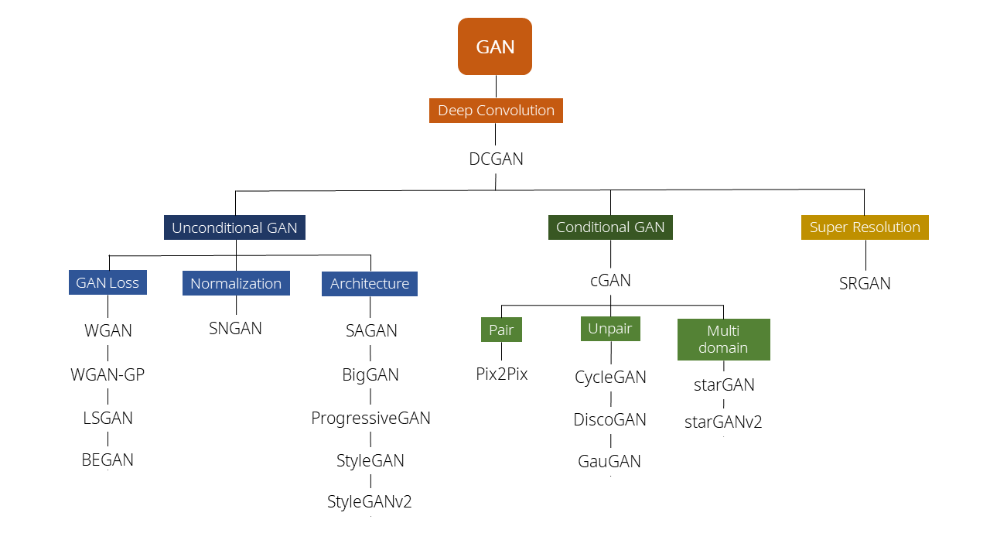
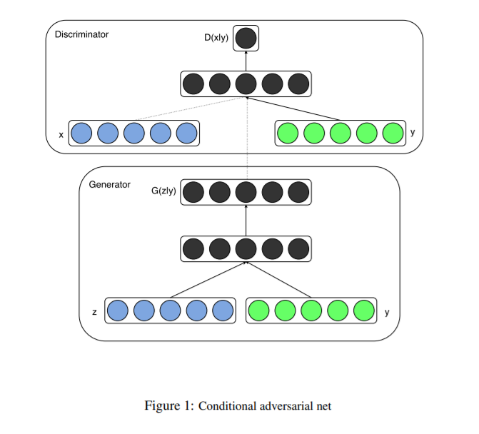
Prerequisites : CGAN
Prior to learning up pix2pix modeling, it is easier to understand with basic knowledge of GAN and CNN. Especially, authors of the paper emphasizes Conditional Adversarial Networks, CGAN.
We are here!
https://ysbsb.github.io/gan/2020/06/17/GAN-newbie-guide.html

Slide 7
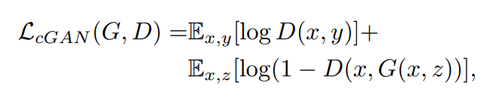
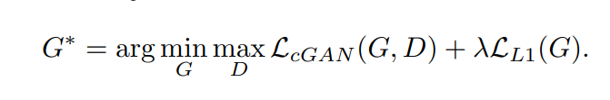

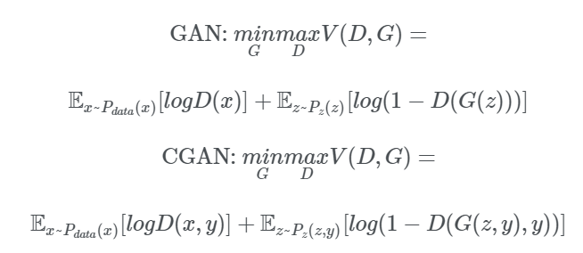
Objective
In the objective of a conditional GAN, G tries to minimize objective against an adversarial D that tries to maximize it, i.e.
Previous approaches have found it beneficial to mix the GAN objective with a more traditional loss, such as L2 distance(or L1 distance). So paper also explore this option, using L1 distance rather than L2 distance. Because L1 encourages less blurring.
This motivates restricting the GAN discriminator to only model high-frequency structure, relying on an L1 term to force low-frequency correctness.
https://arxiv.org/abs/1611.07004

Slide 8
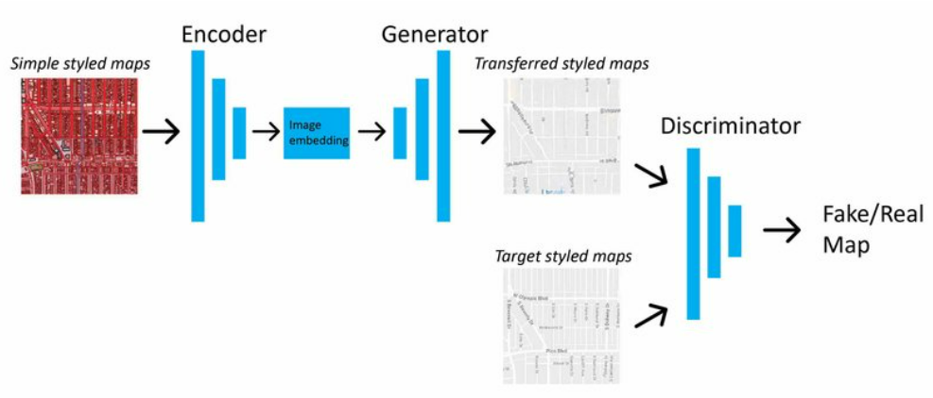
Network Architecture
Adapt generator and discriminator architectures from Unsupervised representation learning with deep convolutional generative adversarial networks
Both generator and discriminator use modules of the form convolution-BathNorm-ReLu
https://www.researchgate.net/figure/Data-flow-of-Pix2Pix-in-this-research_fig2_332932603

Slide 9
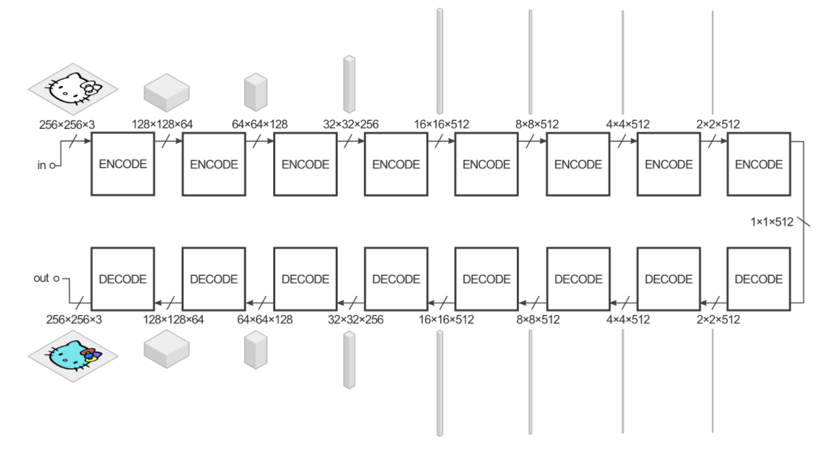
Generator with skip connection
The generator takes some input and tries to reduce it with a series of encoders (convolution + activation function) into a much smaller representation. The idea is that by compressing it this way we hopefully have a higher level representation of the data after the final encode layer.
The decode layers do the opposite (deconvolution + activation function) and reverse the action of the encoder layers
https://affinelayer.com/pix2pix/

Slide 10
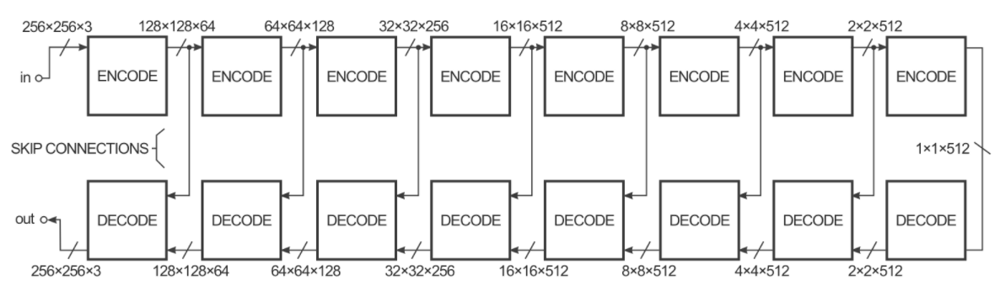
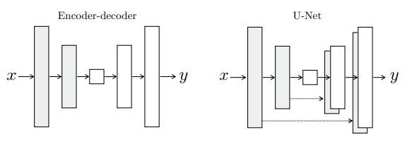
Generator with skip connection
In order to improve the performance of the image-to-image transform in the paper, the authors used a "U-Net" instead of simple encoder-decoder architecture. This is the same thing, but with "skip connections" directly connecting encoder layers to decoder layers.
The skip connections give the network the option of bypassing the encoding/decoding part so that share the low-level information between the input and output.
https://affinelayer.com/pix2pix/

Slide 11
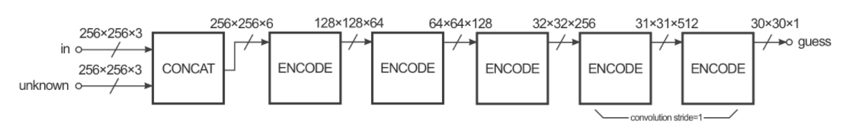
Discriminator with PatchGAN
The Discriminator has the job of taking two images, an input image and an unknown image (which will be either a target or output image from the generator), and deciding if the second image was produced by the generator or not.
https://affinelayer.com/pix2pix/

Slide 12
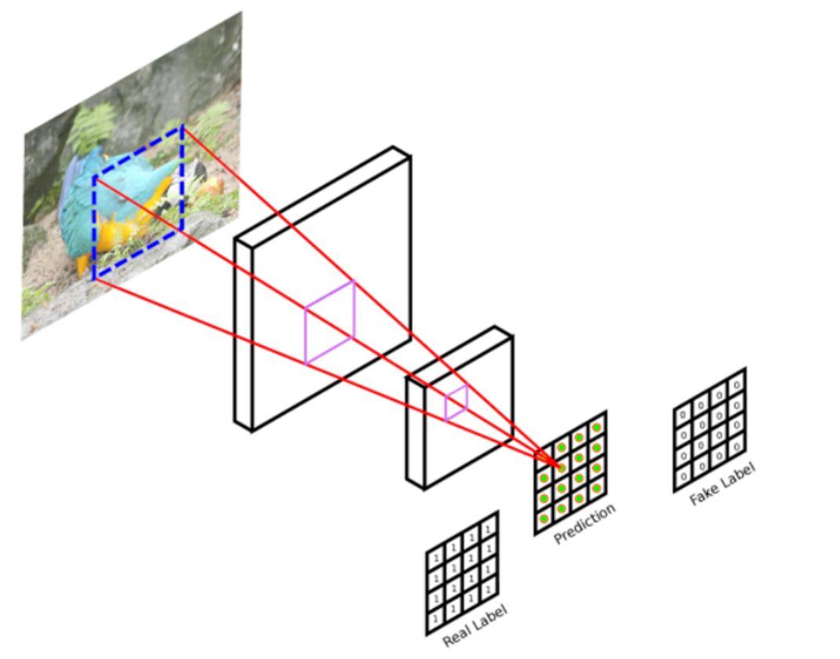
Discriminator with PatchGAN
The Discriminator concentrate on high-frequency structure (relying on an L1 term to force low-frequency correctness), it is sufficient to restrict our attention to the structure in local image patches.
Discriminator tries to classify if each N ×N patch in an image is real or fake. We run this discriminator convolutionally across the image, averaging all responses to provide the ultimate output of D.
Advantage of PatchGAN
- A smaller PatchGAN has fewer parameters
- Can be applied to arbitrarily large images
https://m.blog.naver.com/PostView.naver?isHttpsRedirect=true&blogId=laonple&logNo=221366130381

Slide 13
Optimization and inference
Alternate between one gradient descent step on D, then one step on G. D-> G -> D -> G…
Train to maximize rather than minimize
Use minibatch SGD and apply the Adam solver with a learning rate of 0.0002, and momentum parameters (Check this out in later code)
Divide the objective by 2 while optimizing D, which slows down the rate at which D learns relative to G.
At inference time, run the generator net in exactly the same manner as during the training phase.
In experiments, use batch sizes between 1 and 10 depending on the experiment.

Slide 14
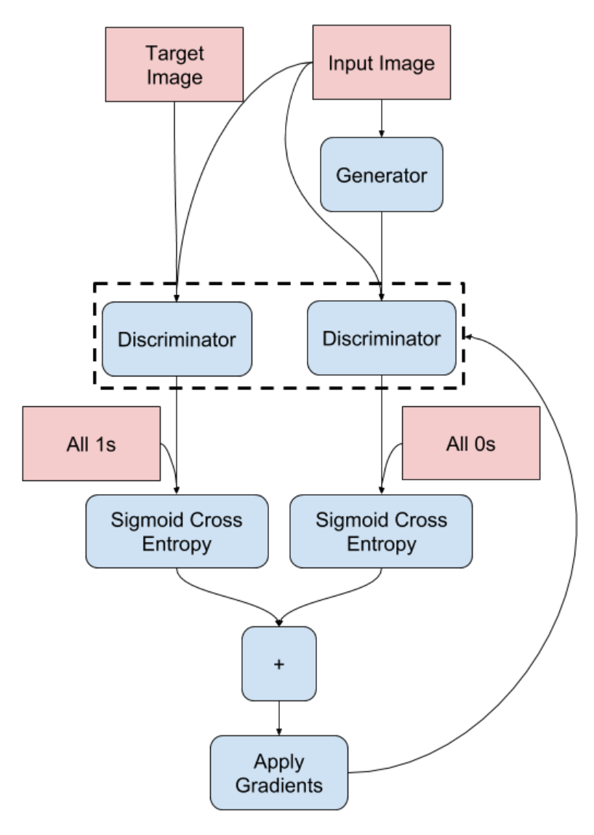
Optimization and inference
Discriminator
The discriminator looks at the input/target pair and the input/output(which Generator create) pair and produces its guess about how realistic they look.
The update parameter by using correct guesses (which discriminator guesses input/target as true OR vise versa)
https://www.tensorflow.org/tutorials/generative/pix2pix

Slide 15
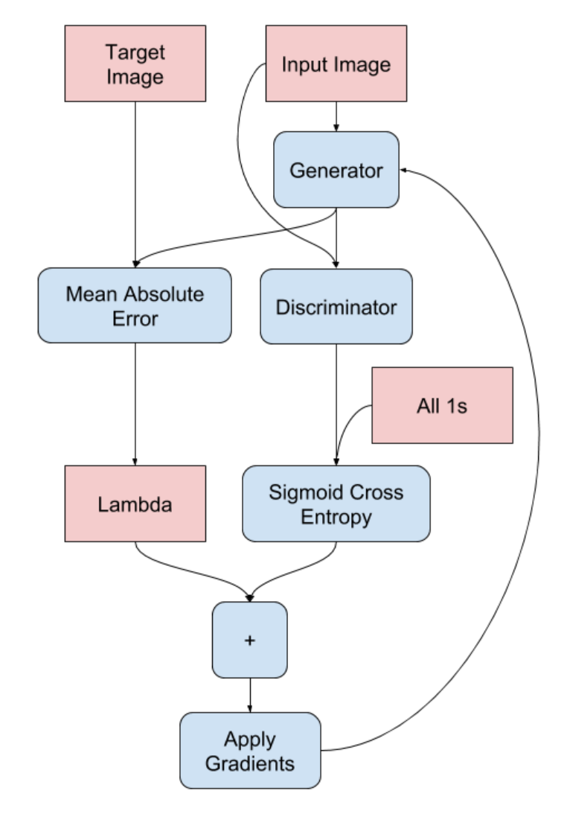
Optimization and inference
Generator
The generator model is trained via the discriminator model. It is updated to minimize the loss predicted by the discriminator for generated images marked as “real.”
The generator is also updated to minimize the L1 loss or mean absolute error between the generated image and the target image.
https://www.tensorflow.org/tutorials/generative/pix2pix

Slide 16
Experiments with source code
https://machinelearningmastery.com/how-to-develop-a-pix2pix-gan-for-image-to-image-translation/

Slide 17
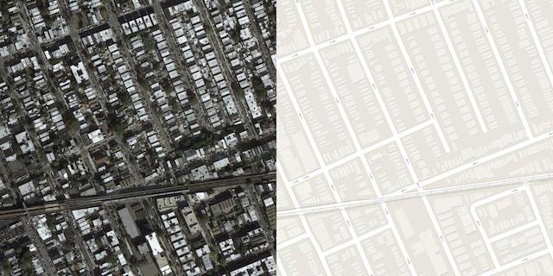
Load Image
In this tutorial, we will use the so-called “maps” dataset used in the Pix2Pix paper. This is a dataset comprised of satellite images of New York and their corresponding Google maps pages. Each image is 1,200 pixels wide and 600 pixels tall and contains both the satellite image on the left and the Google maps image on the right.
Download dataset : http://efrosgans.eecs.berkeley.edu/pix2pix/datasets/maps.tar.gz
https://machinelearningmastery.com/how-to-develop-a-pix2pix-gan-for-image-to-image-translation/

Slide 18
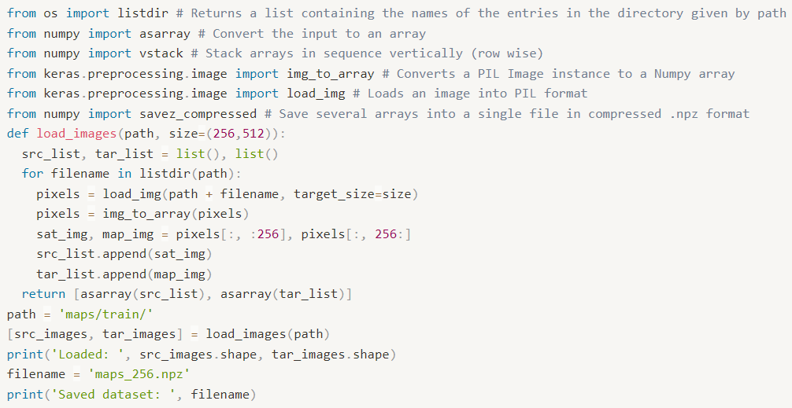
Load Image
We can prepare this dataset for training a Pix2Pix GAN model in Keras. We will just work with the images in the training dataset. Each image will be loaded, rescaled, and split into the satellite and Google map elements. The result will be 1,097 color image pairs with the width and height of 256×256 pixels.
[1]
Copying
https://machinelearningmastery.com/how-to-develop-a-pix2pix-gan-for-image-to-image-translation/

Slide 19
Load Image
This function enumerates the list of images in a given directory, loads each with the target size of 256×512 pixels, splits each image into satellite and map elements and returns an array of each.
https://machinelearningmastery.com/how-to-develop-a-pix2pix-gan-for-image-to-image-translation/

Slide 20
Load Image
Running the example loads all images in the training dataset, summarizes their shape to ensure the images were loaded correctly, then saves the arrays to a new file called maps_256.npz in compressed NumPy array format.
https://machinelearningmastery.com/how-to-develop-a-pix2pix-gan-for-image-to-image-translation/

Slide 21
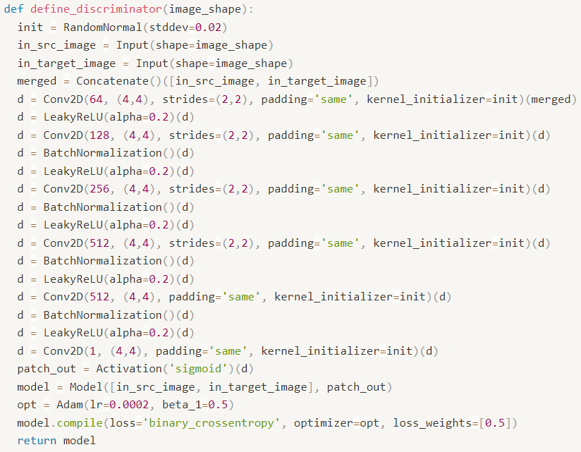
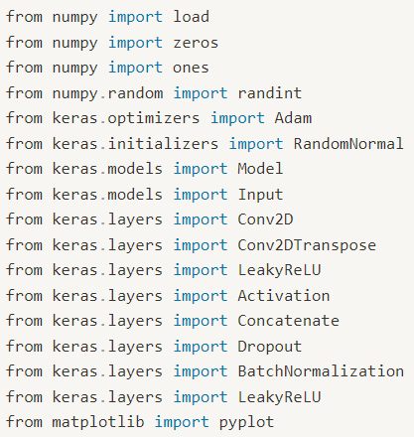
Define Discriminator
[3]
Copying
[2]
Copying
https://machinelearningmastery.com/how-to-develop-a-pix2pix-gan-for-image-to-image-translation/

Slide 22
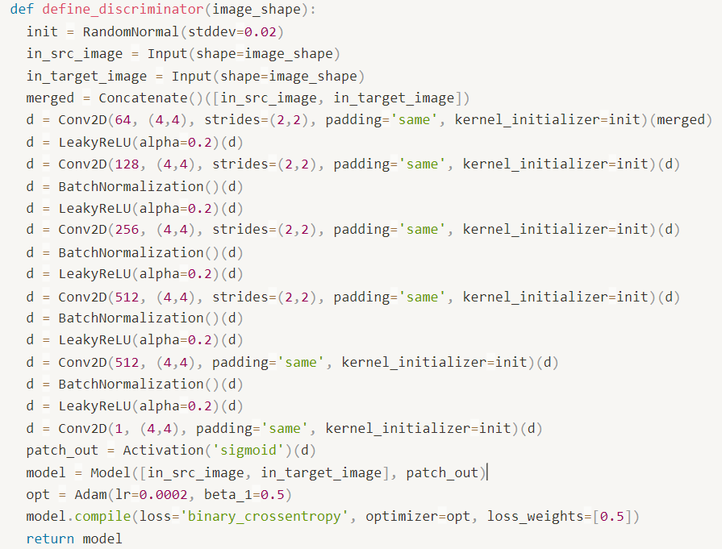
Define Discriminator
Model weights were initialized via random Gaussian with a mean of 0.0 and standard deviation of 0.02. Images input to the model are 256×256.
The model takes two images as input, specifically a source and a target image. These images are concatenated together at the channel level, e.g. 3 color channels of each image become 6 channels of the input.
https://machinelearningmastery.com/how-to-develop-a-pix2pix-gan-for-image-to-image-translation/

Slide 23
Define Discriminator
A convolution is applied after the last layer to map to a 1-dimensional output, followed by a Sigmoid function. BatchNorm is not applied to the first C64 layer. All ReLUs are leaky, with slope 0.2. The kernel size is fixed at 4×4 and a stride of 2×2 is used on all but the last 2 layers of the model.
https://machinelearningmastery.com/how-to-develop-a-pix2pix-gan-for-image-to-image-translation/

Slide 24
Define Discriminator
The 70×70 discriminator architecture is defined using a shorthand notation as: C64-C128-C256-C512, where C refers to a block of Convolution-BatchNorm-LeakyReLU layers and the number indicates the number of filters.
3
70×70 discriminator architecture : C64-C128-C256-C512
6
64
128
256
512
512
1
32x32
16x16
16x16
16x16
128x126
64x64
Stride = 1
256x256
256x266
Concatenate
Batch
Norm.
Leaky
ReLU
Conv2D
Sigmoid

Slide 25
Define Discriminator
The model is trained with a batch size of one image and the Adam version of stochastic gradient descent is used with a small learning range and modest momentum. The loss for the discriminator is weighted by 50% for each model update.
https://machinelearningmastery.com/how-to-develop-a-pix2pix-gan-for-image-to-image-translation/

Slide 26
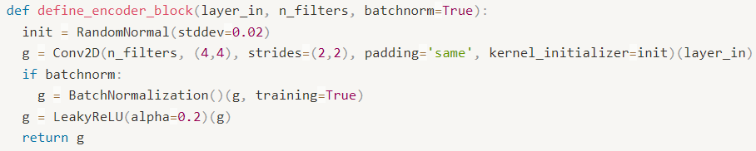
Define Generator(encoder_block)
Encoder_block captures the context of an image.
Encoder_block contains previous layer, number of filters, batchnorm(boolean) as parameter
Encoder_block is made up with (Conv-> Batchnorm-> Leaky ReLU)
[4]
Copying
https://machinelearningmastery.com/how-to-develop-a-pix2pix-gan-for-image-to-image-translation/

Slide 27
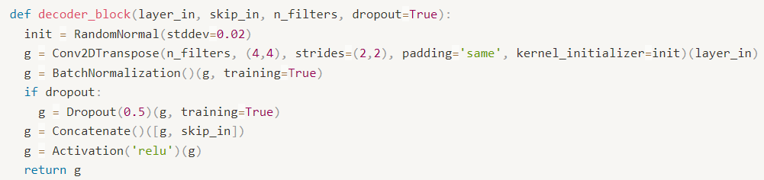
Define Generator(decorder_block)
Decoder_block is Opposition of encoder_block, it localizes feature map
Similar parameters with encoder, but additionally use skip connection layer and dropout(boolean)
Decoder_block is made of with (Transposed Conv-> Batchnorm-> Dropout (first 3 blocks)
-> ReLU)
[5]
Copying
https://machinelearningmastery.com/how-to-develop-a-pix2pix-gan-for-image-to-image-translation/

Slide 28
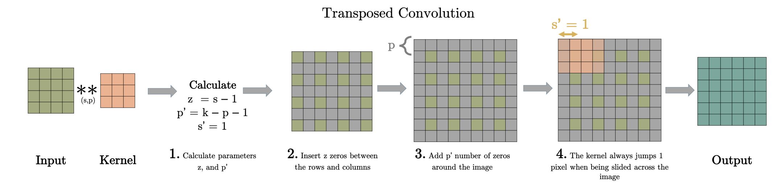
Define Generator(decorder_block)
Conv2DTranspsose func work this way!!
For U-net skip architecture concatenate up-conv feature map and feature map in encoding stage
https://machinelearningmastery.com/how-to-develop-a-pix2pix-gan-for-image-to-image-translation/

Slide 29
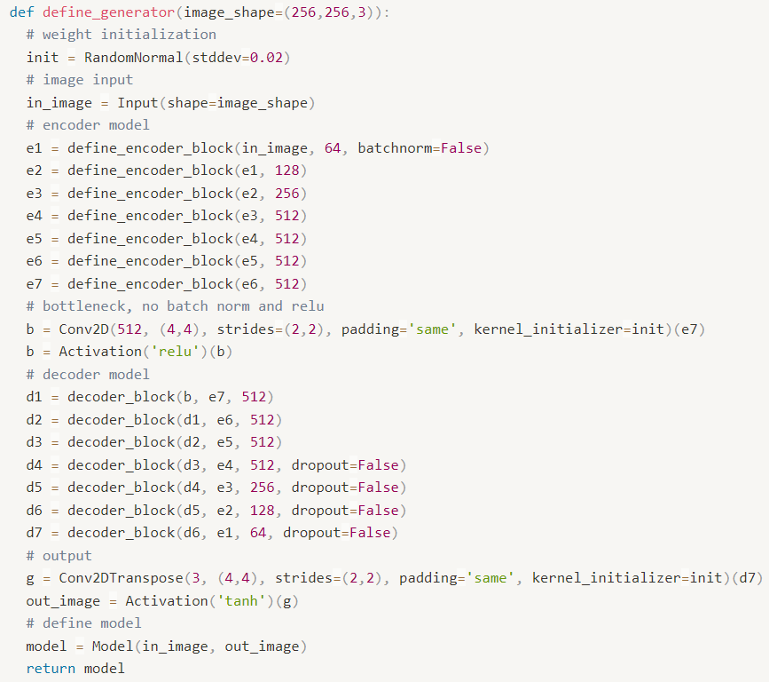
Define Generator
Implement generator using encoder and decoder block
Generator outputs pair of in_image, out_image
[6]
Copying
https://machinelearningmastery.com/how-to-develop-a-pix2pix-gan-for-image-to-image-translation/

Slide 30
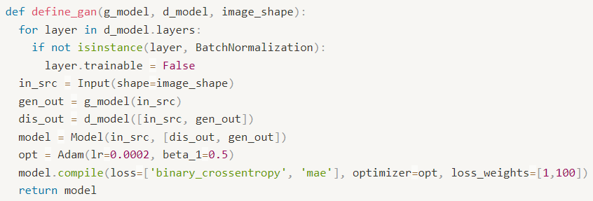
Define GAN
The define_gan() function below implements this, taking the already-defined generator and discriminator models as arguments and using the Keras functional API to connect them together into a composite model.
Both loss functions are specified for the two outputs of the model and the weights used for each are specified in the loss_weights argument to the compile() function.
[7]
Copying
https://machinelearningmastery.com/how-to-develop-a-pix2pix-gan-for-image-to-image-translation/

Slide 31
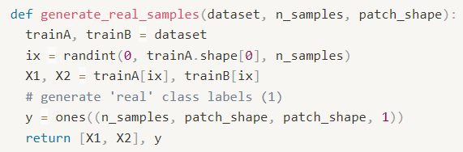
Define generate_real_samples
The generate_real_samples() function below will prepare a batch of random pairs of images from the training dataset, and the corresponding discriminator label of class=1 to indicate they are real.
[8]
Copying
trainA = dataset[0]
tranB = dataset[1]
TrainA.shape = [1096, 256, 256, 3]
n_samples = number of select images
https://machinelearningmastery.com/how-to-develop-a-pix2pix-gan-for-image-to-image-translation/

Slide 32
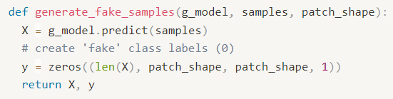
Define generate_fake_samples
The generate_fake_samples() function below uses the generator model and a batch of real source images to generate an equivalent batch of target images for the discriminator.
[9]
samples = value of return 'generate_real_samples' X1
That means create fake samples from real samples
Copying
https://machinelearningmastery.com/how-to-develop-a-pix2pix-gan-for-image-to-image-translation/

Slide 33
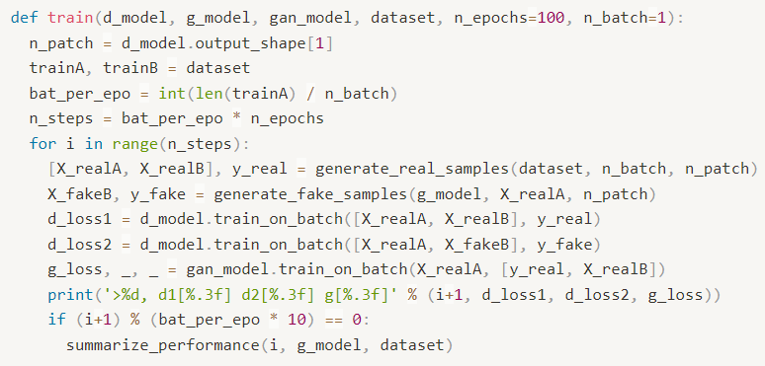
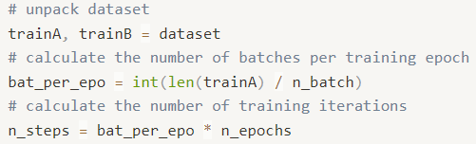
Define Train
The train() function below implements this, taking the defined generator, discriminator, composite model, and loaded dataset as input. The number of epochs is set at 100 to keep training times down, although 200 was used in the paper. A batch size of 1 is used as is recommended in the paper.
Training involves a fixed number of training iterations. There are 1,097 images in the training dataset. One epoch is one iteration through this number of examples, with a batch size of one means 1,097 training steps. The generator is saved and evaluated every 10 epochs or every 10,970 training steps, and the model will run for 100 epochs, or a total of 109,700 training steps.
[10]
Copying
d.model.output_shape : (None, 16, 16, 1) -> n_patch = 16 왜..?
trainA, trainB = dataset -> dataset[0] is sat_img , dataset[1] is map_img
https://machinelearningmastery.com/how-to-develop-a-pix2pix-gan-for-image-to-image-translation/

Slide 34
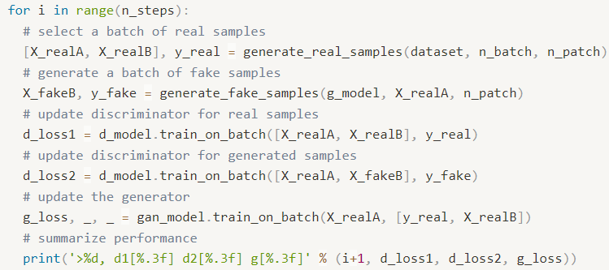
Define Train
[11]
Copying
d_loss1 = gap of target and source -> real pair
d_loss2 = gap of fake_target(create by generator) and source -> fake pair
Source : 위성 사진
Target : 지도 사진
Fake target : generator가 source로 부터 생성한 fake
https://machinelearningmastery.com/how-to-develop-a-pix2pix-gan-for-image-to-image-translation/

Slide 35
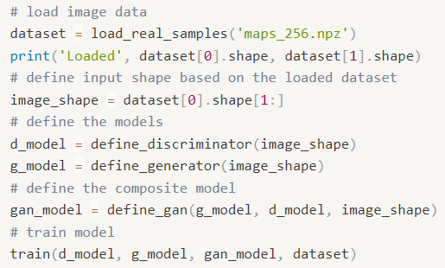
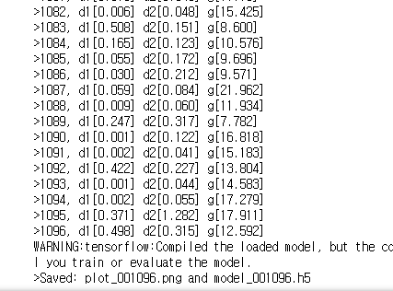
Play train
[12]
Copying
This example epochs = 1 , n_patch =1
https://machinelearningmastery.com/how-to-develop-a-pix2pix-gan-for-image-to-image-translation/

